Slide 1

Health Roof
CAPSTONE PROJECT
FALL SEMESTER 2022-23
Review 3
All in One Solution

Slide 2
Guided By- Prof. D.Sumathi Mam
Done By-​
Y.Avinash Mani Kiran – 19BCE7466​
S.Lakshmi Prasanna – 19BCE7317​
M.Amulya - 19BCE7752

Slide 3
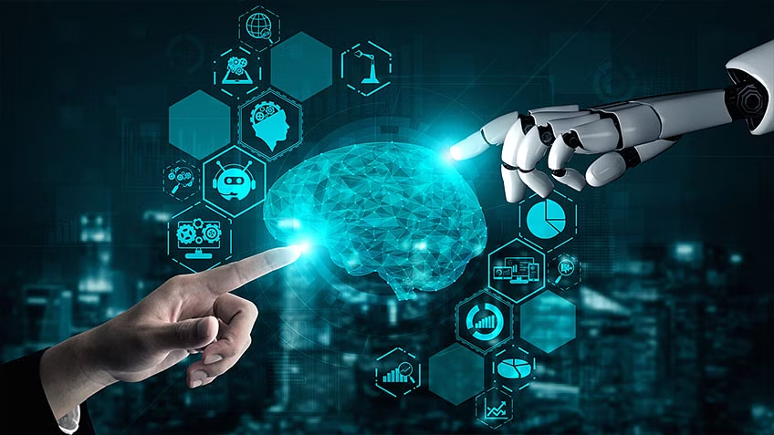
RESULTS

Slide 4
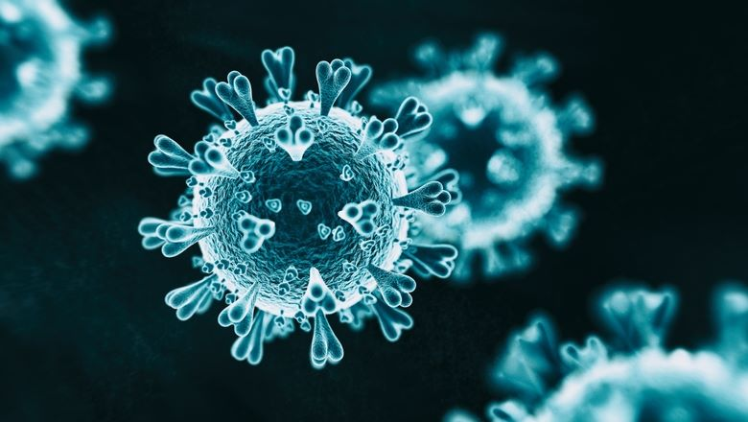
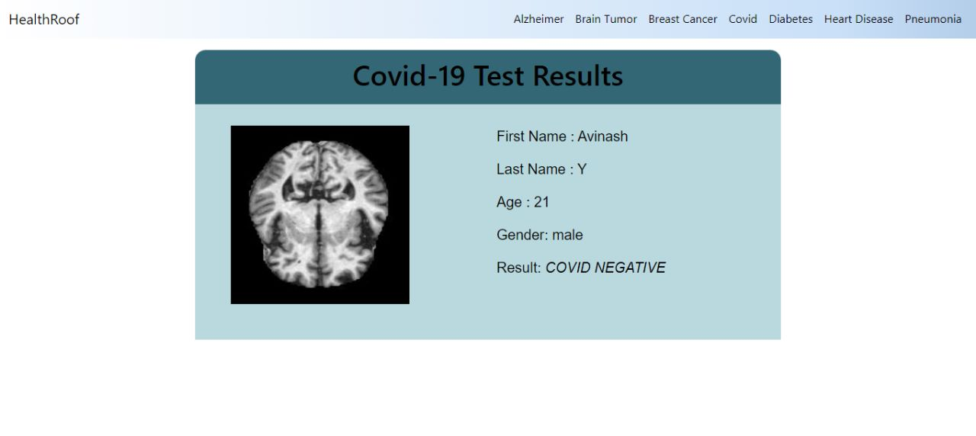

Slide 5
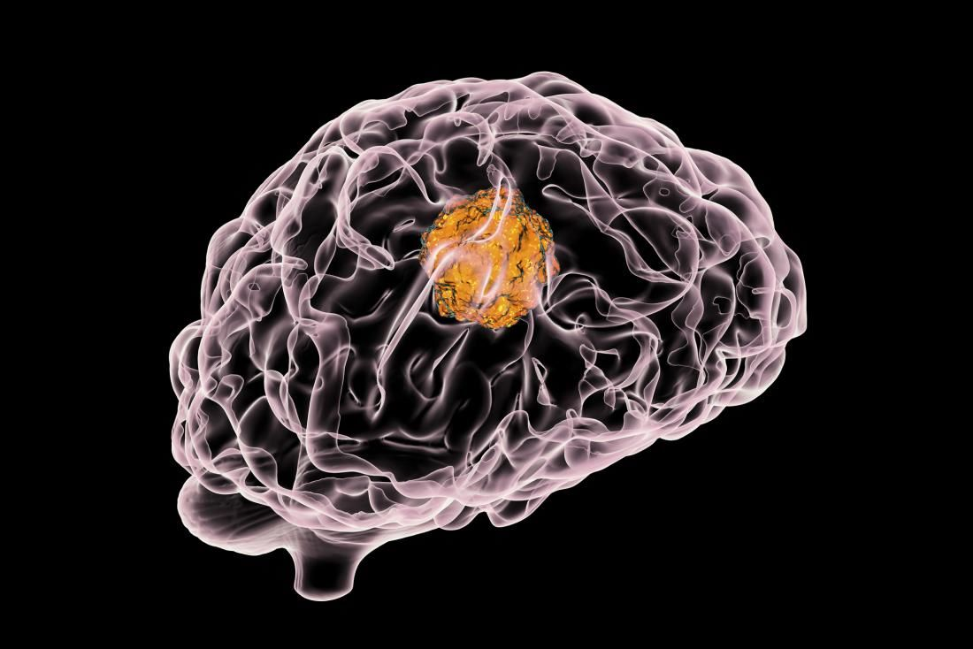
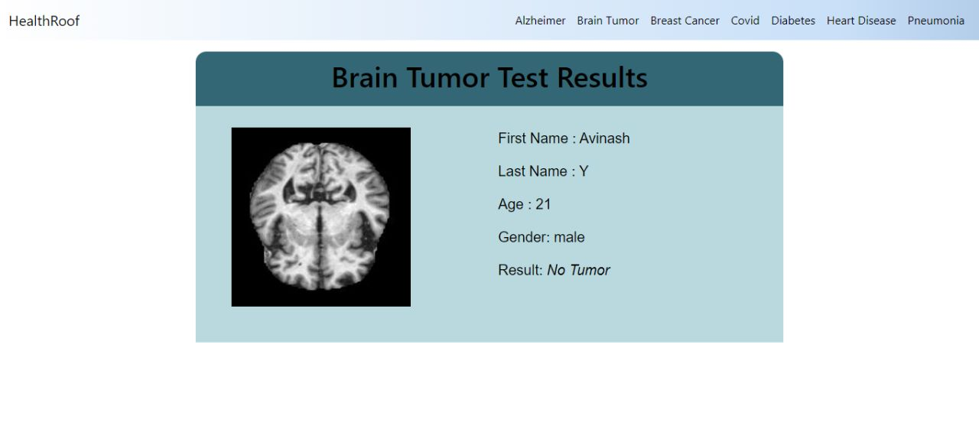

Slide 6

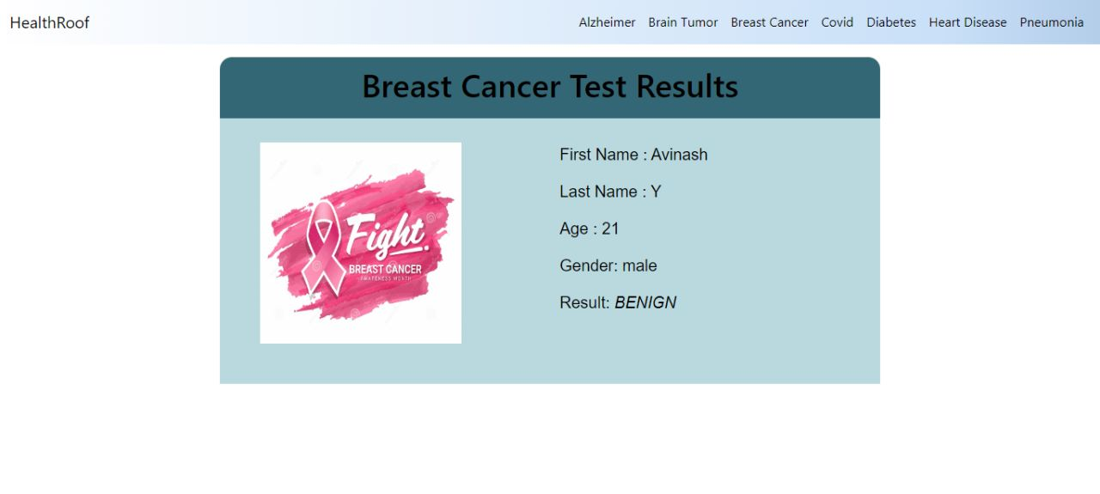

Slide 7
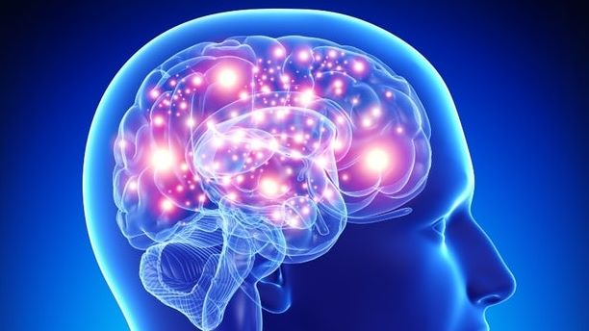
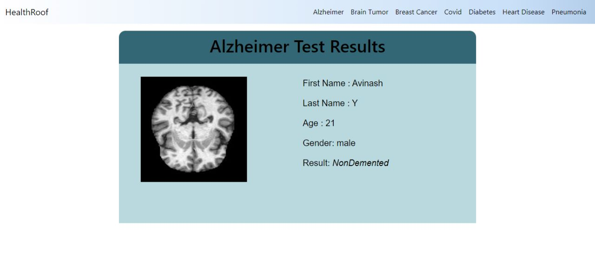

Slide 8

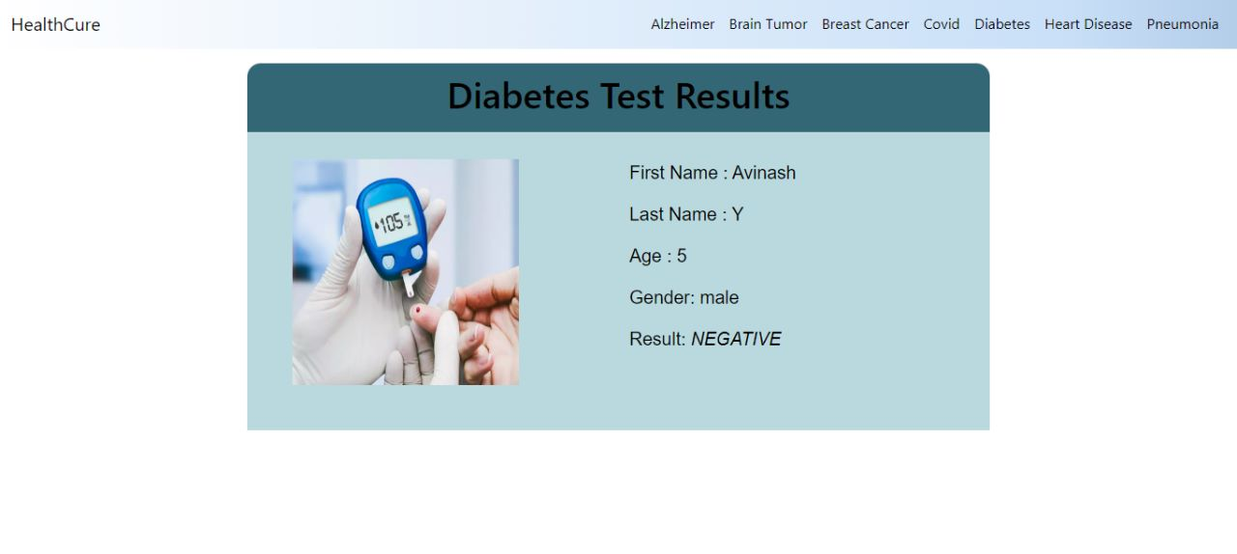

Slide 9
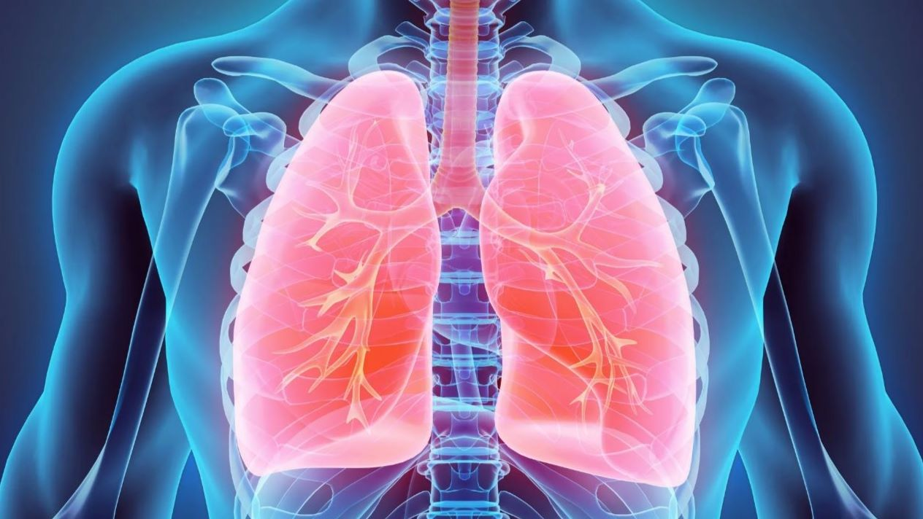
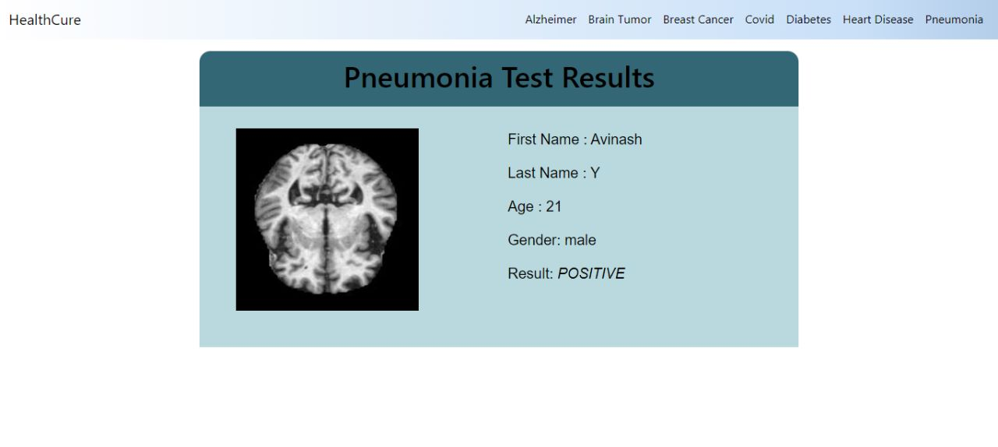

Slide 10

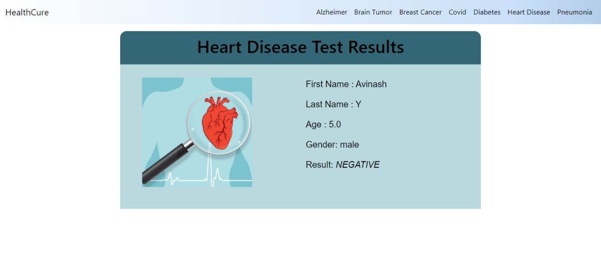

Slide 11

Applications
Disease detection is one field where intervention of human experts is required ,through HealthRoof this process is simplified.
Adding more disease detections which can be detected using X-ray scans or just by inputting simple numbers will be more effective
We can add more various features like if a person is found positive then precautions can be displayed
Even can be modified by providing a feature to book online appointments based on severity level.

Slide 12
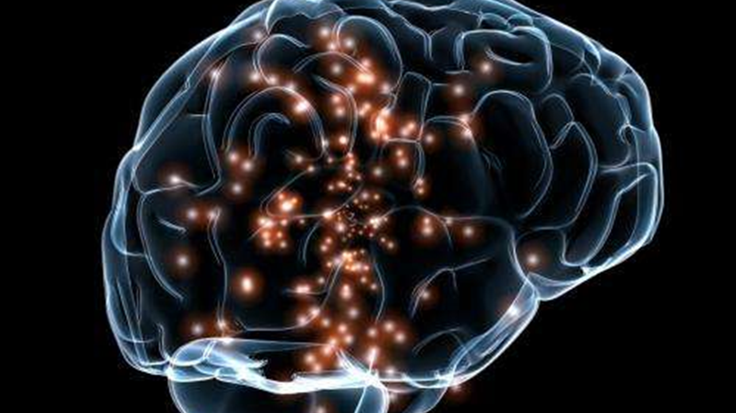
CONCLUSION
Artificial intelligence (AI) is gradually changing medical practice. With recent progress in digitized data acquisition, machine learning and computing infrastructure, AI applications are expanding into areas that were previously thought to be only the province of human experts.Recent breakthroughs in AI technologies and their biomedical applications, identify the challenges for further progress in medical AI systems, and summarize the economic, legal and social implications of AI in healthcare.
Through this we bring all disease detection under one roof and makes disease detection one click away.
HEALTH ROOF ….
ALL IN ONE SOLUTION

Slide 13

THANK YOU

